Slide 1
Homework 1 Has Been Posted!

Slide 2

CSC 2302/DSCI 1302 Recursion
- S M Towhidul Islam

Slide 3

Introduction to Recursion
8
7
6
5
4
3
2
1
How many people on the queue?

Slide 4
Introduction to Recursion
A problem-solving technique
A recursive function - divides the problem into smaller sub-problems
Invokes itself on the sub-problems with different inputs
Continue the process until desired sub-problem(s) is reached
The function returns result from that point
Solutions to smaller sub-problems solves the original problem

Slide 5
Recursive function
A function that calls itself is called a recursive function.
def person_count(person): if no_person_ahead: return 1 else: return 1+person_count(next_person)

Slide 6
Recursive function – another example
Count down using recursion:
def count(n): if n == 0: print('Go!') else: print(n) count(n-1) count(2)

Slide 7
Structure of a recursive function
Recursive functions consists of:
Base case: Every recursive function must have one/more case(s) where it doesn’t make any further recursive calls.
Recursive case: Every recursive function should have one/more case(s) where it breaks down the problem into smaller problem(s) and make recursive calls.

Slide 8
Structure of a recursive function
Identify the base case(s) and recursive case(s) within the following recursive function:
def count(n): if n == 0: print('Go!') else: print(n) count(n - 1)

Slide 9
How recursion works
def count(n): if n == 0: print('Go!') else: print(n) count(n - 1)
count(3)
>> 3
>> 2
count(0)
>> 1
>> Go!
count(1)
count(2)
count(3)
Stack
Output

Slide 10
How recursion works
def count(n): if n == 0: print('Go!') else: print(n) count(n - 1) print(n) count(3)
>> 3
>> 2
count(0)
>> 1
>> Go!
count(1)
>> 1
count(2)
>> 2
>> 3
count(3)
Stack
Output

Slide 11
Suggested Reading – ZyBook 14.1

Slide 12
Example problems
Problem analysis:
One or more similar sub-problem (recursive case)?
One or more base cases?
Example problem 1: Factorial calculation
Recursive structure:
N! = N × (N-1) × … × 3 × 2 × 1
= N × (N-1)!
Base case(s):
0! = 1

Slide 13
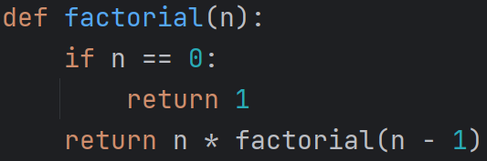
Example problems
Factorial calculation - Recursive solution
Suggested Reading for Factorial Calculation – ZyBook 14.4

Slide 14
Example problems
Example problem 2: Fibonacci sequence generation
Fibonacci sequence: 0, 1, 1, 2, 3, 5, 8, 13 …
Recursive structure:
fib_{N} = fib_{N-1}+ fib_{N-2}
Base case(s):
fib₀ = 0
fib₁ = 1

Slide 15
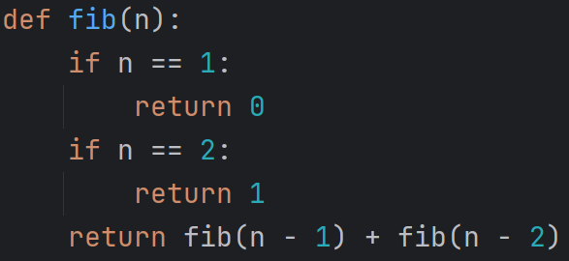
Example problems
Fibonacci sequence generation - Recursive solution

Slide 16
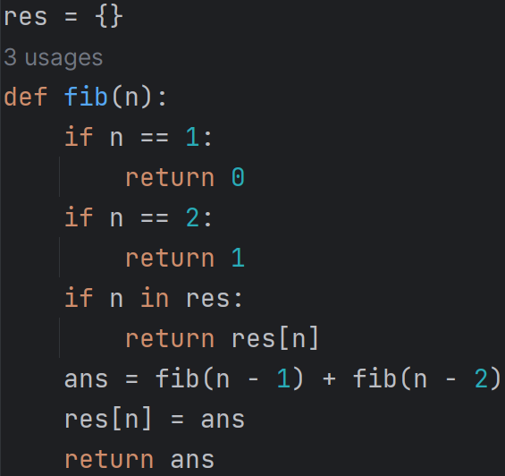
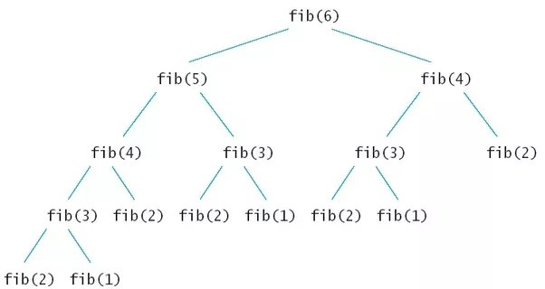
Example problems
Fibonacci sequence generation – a better recursive solution
Recursion with memoization
Issues?

